Slide 1

Aluminum alloy/Magnesium alloy explosive welding: Numerical simulation by SPH method
Qiang Zhou, Jianrui Feng, Pengwan Chen*
Beijing Institute of Technology, Beijing, China
zqpcgm@gmail.com
pengwanchen@bit.edu.cn

Slide 2
SPH is a is a gridless method which has the potential to be both efficient and accurate at modeling material deformation and flexible in terms of the inclusion of specific material models.
SPH method has some special advantages comparing with the traditional grid based numerical method.
Model of explosive welding
M.B. Liu et al. Arch Comput Methods Eng (2010) 17: 25–76

Slide 3
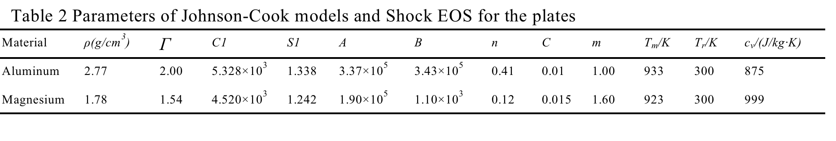
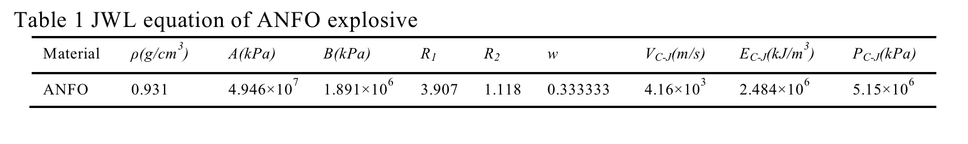
Models and Parameters
JWL EOS for ANFO
The Shock EOS for Plates
The Johnson-cook constitutive model for the plates.
Notes:
These are the models and parameters used in this work.

Slide 4
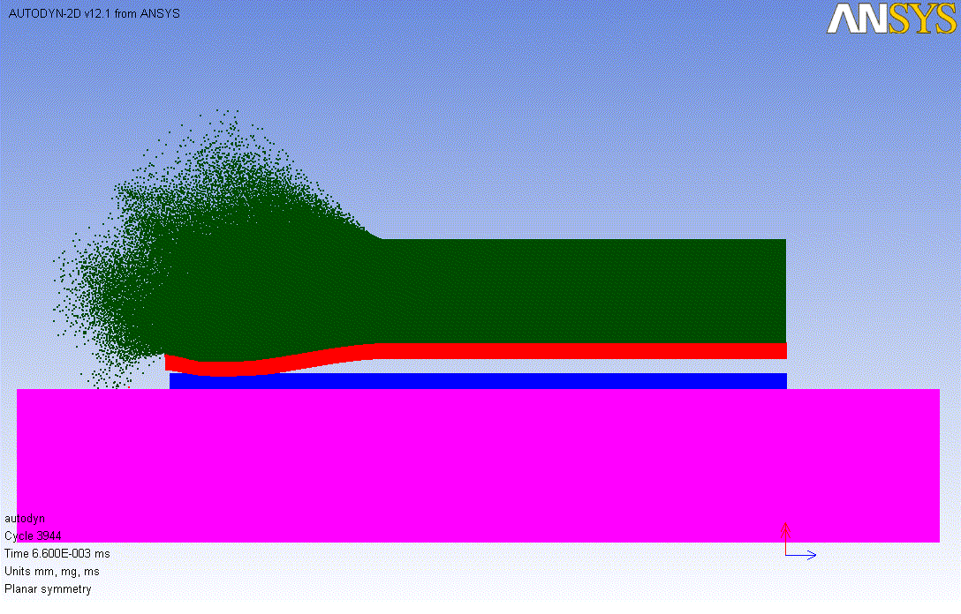
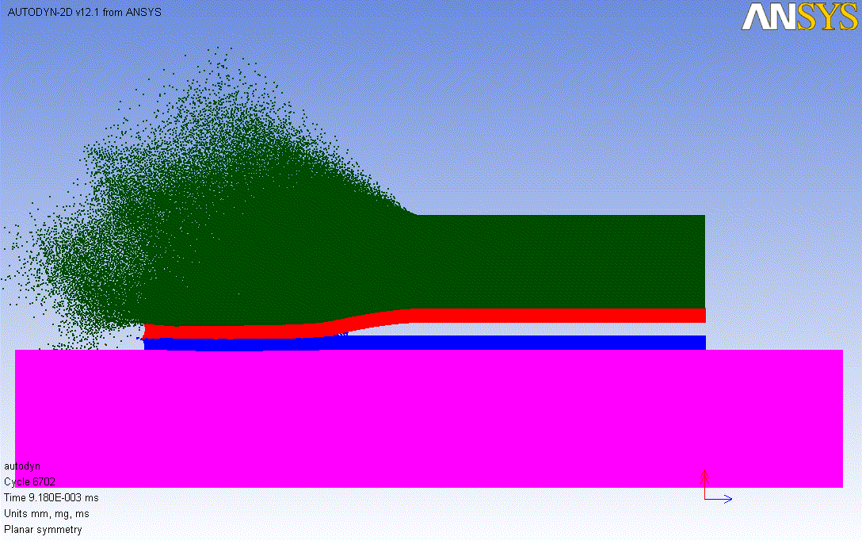
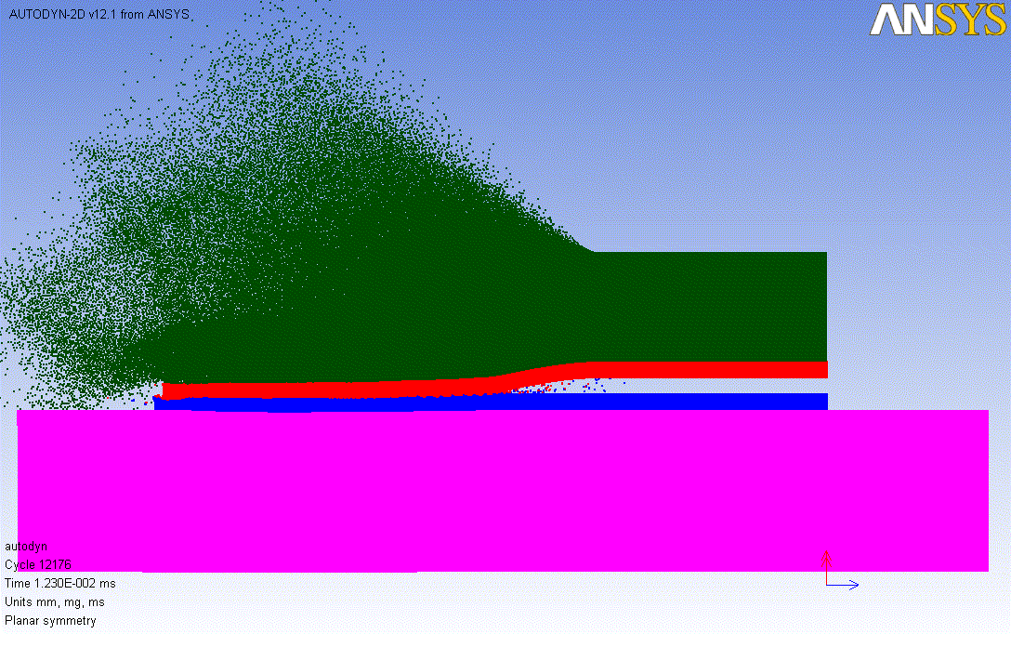
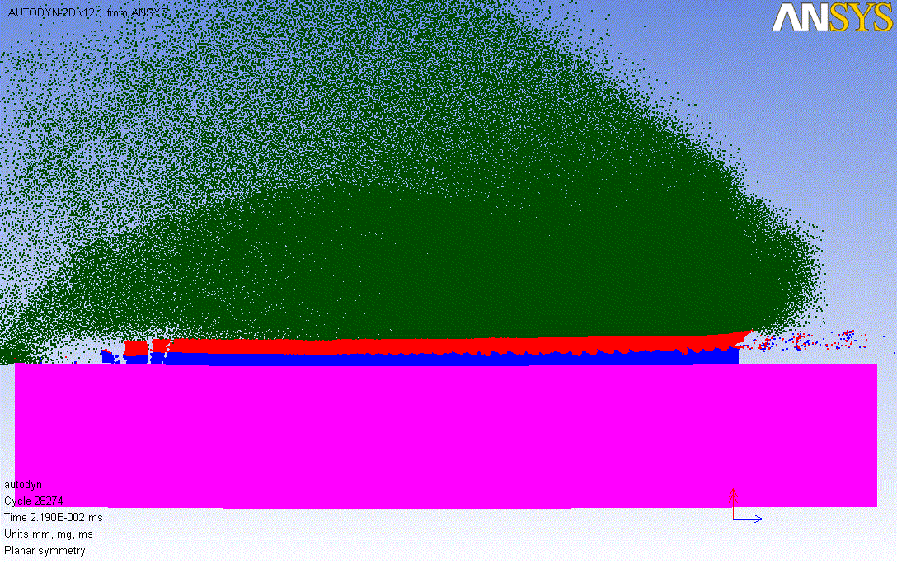
t=6.6us
t=9.2us
t=12.3us
t=21.9us

Slide 5
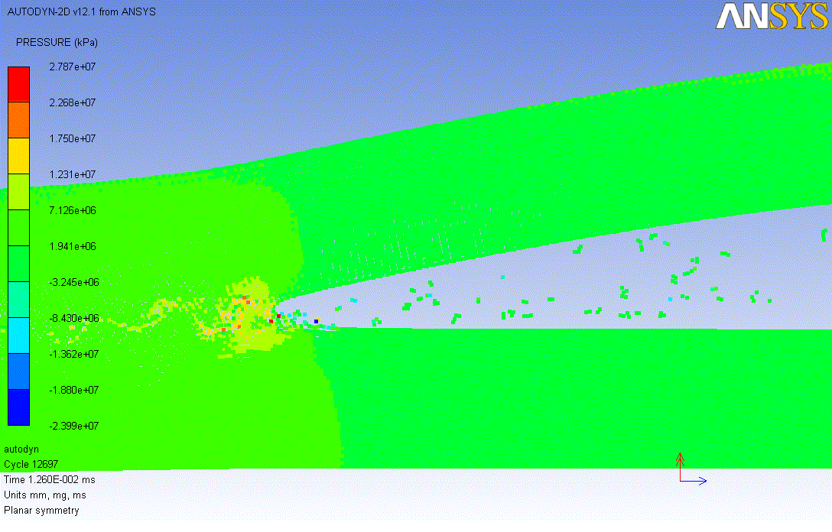
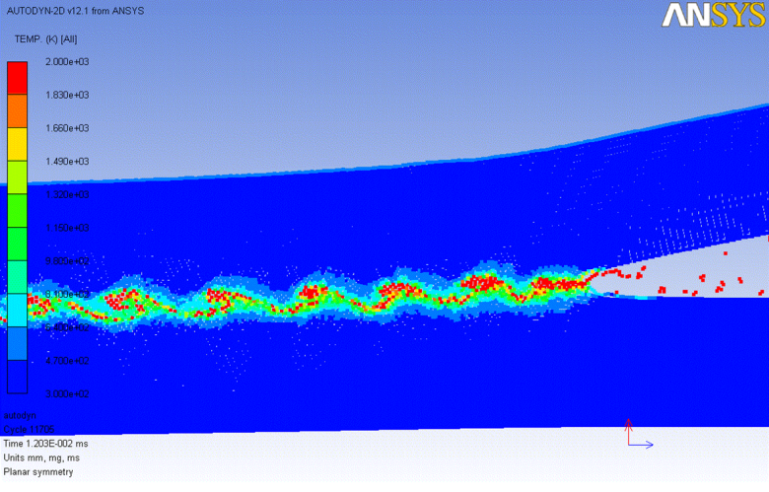
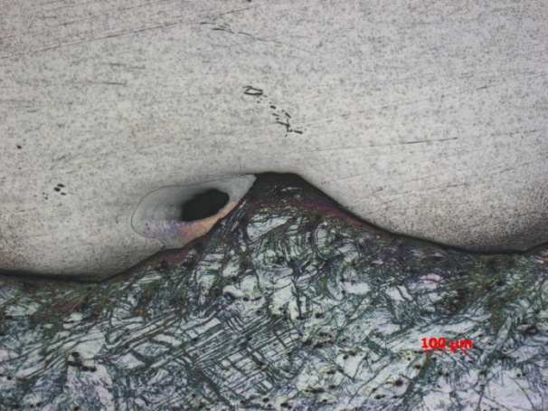
Distribution of Pressure and Temperature
The pressure at collision point is the highest.
The temperature at collision point is higher than melting point.

Slide 6
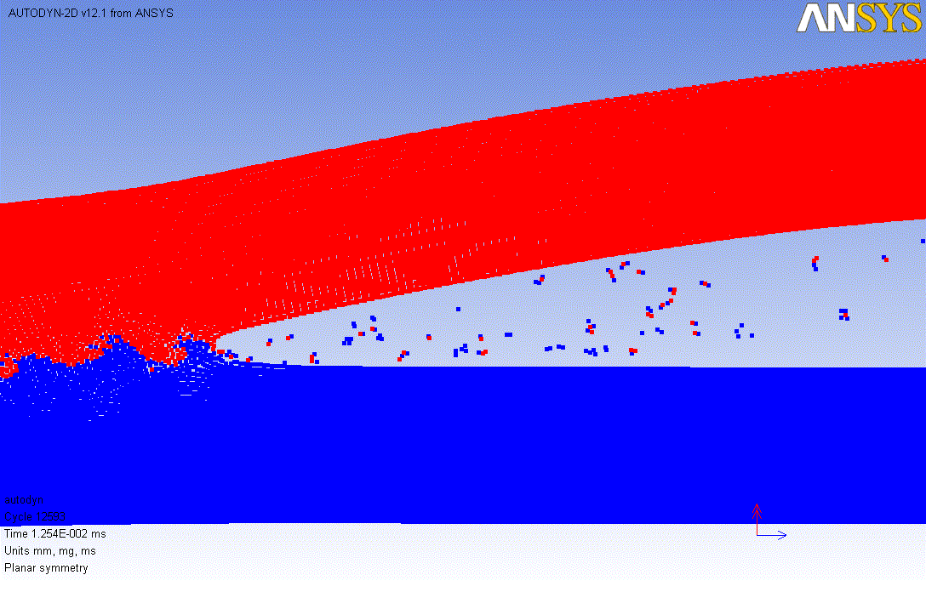
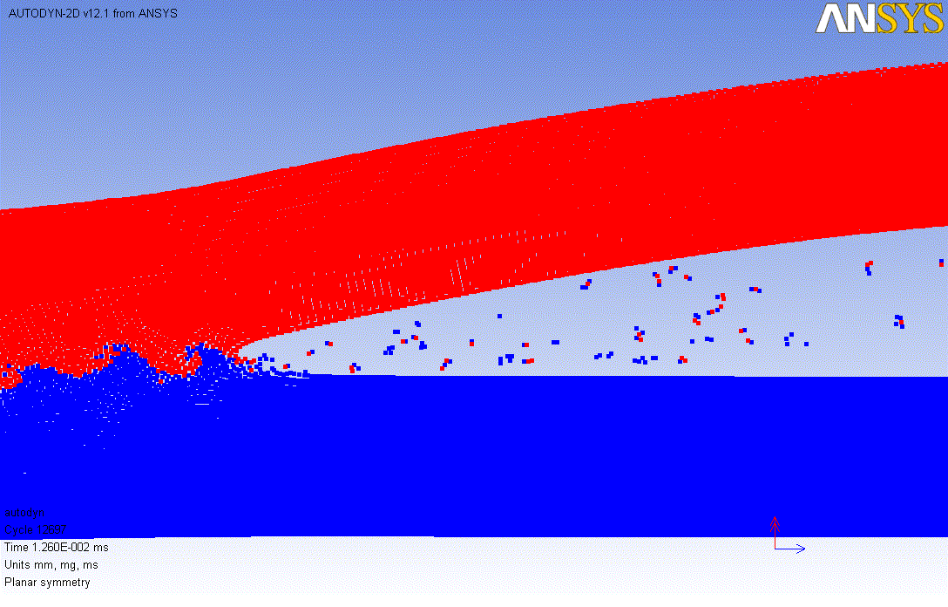
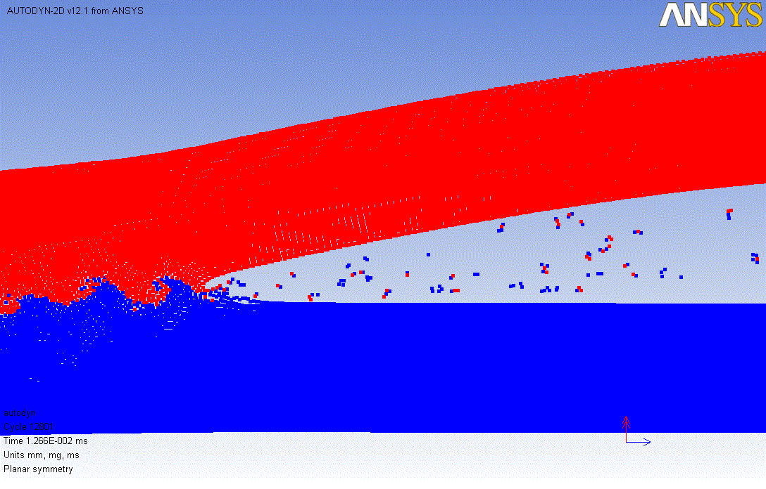
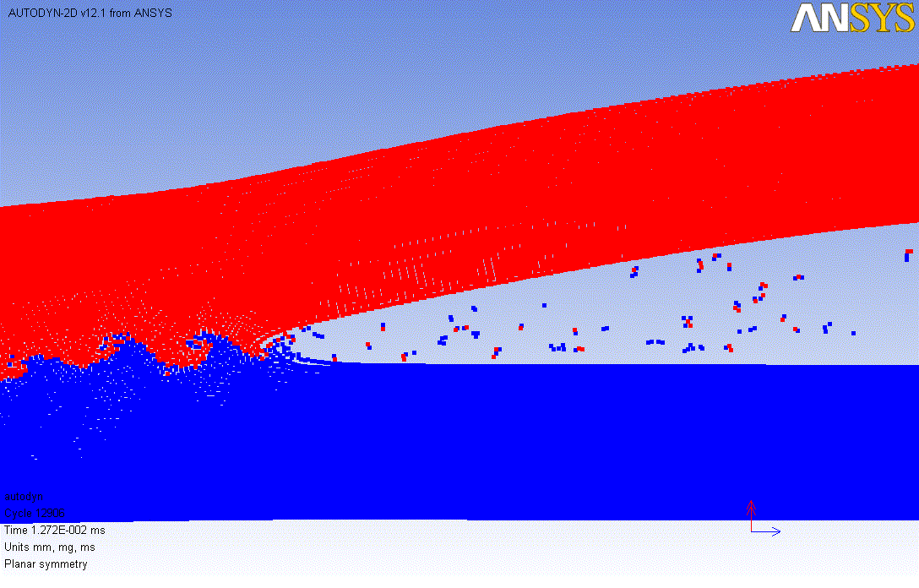
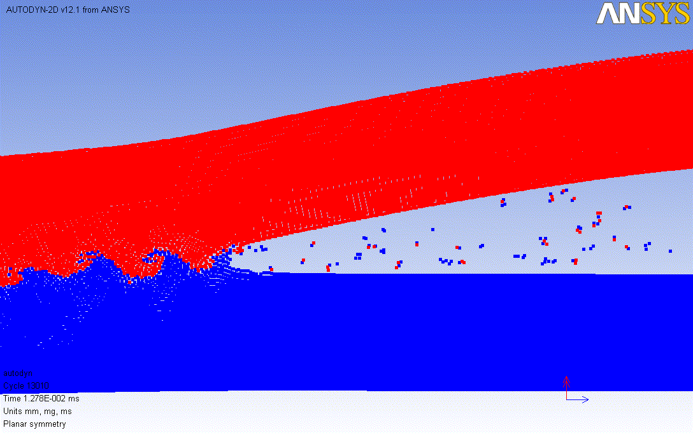

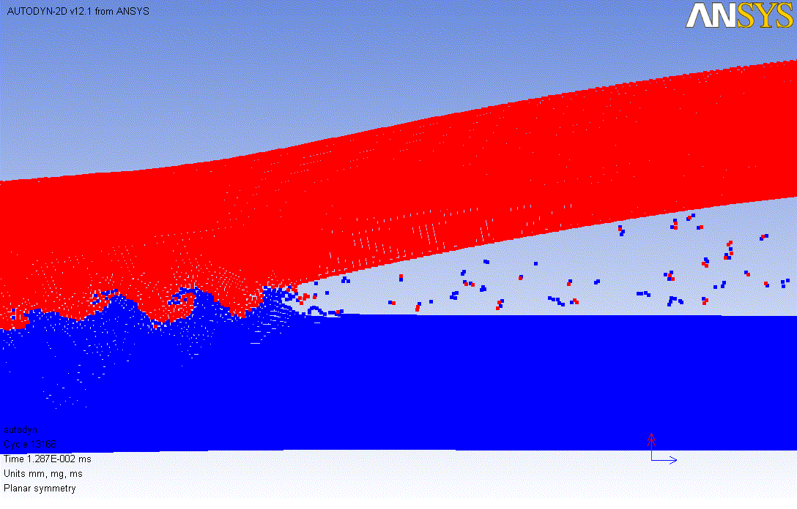
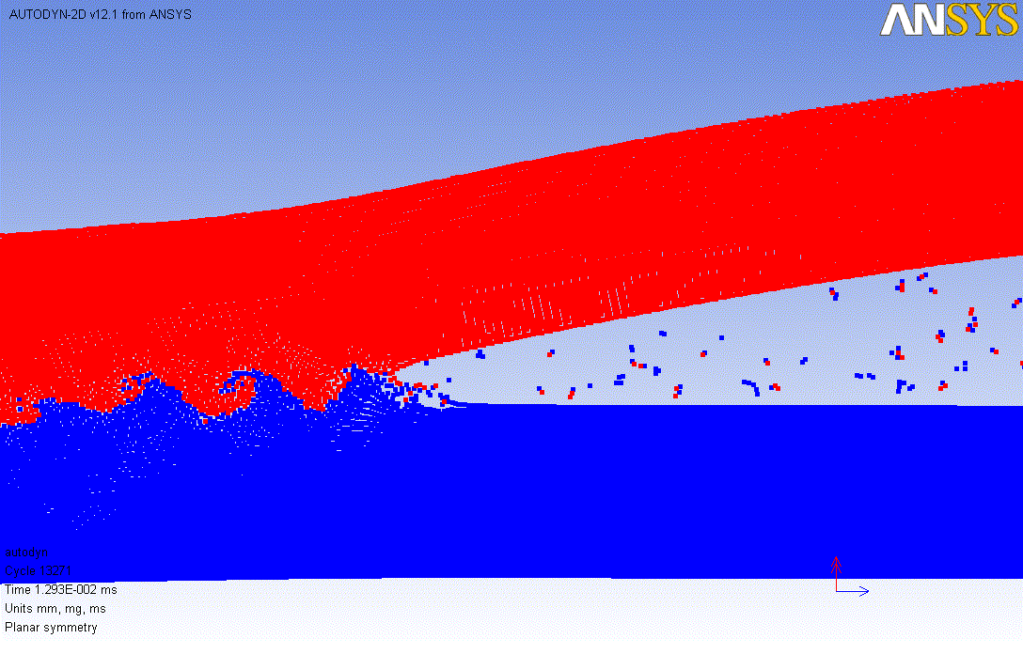
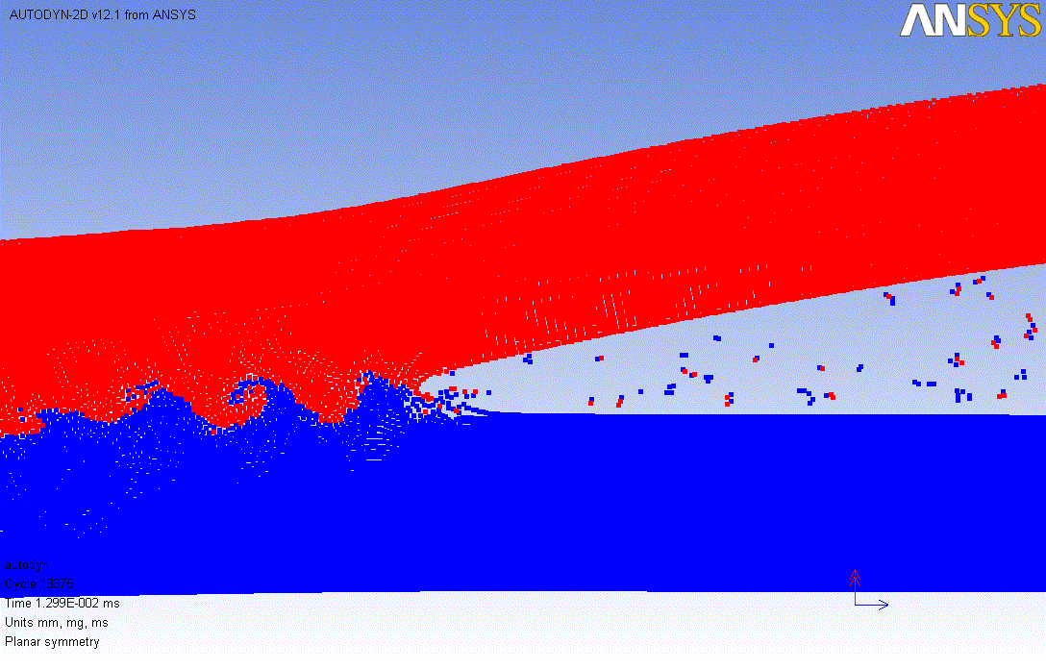
Wave Formation
t=12.54us
t=12.60us
t=12.66us
t=12.72us
t=12.78us
t=12.81us
t=12.87us
t=12.93us
t=12.99us

Slide 7
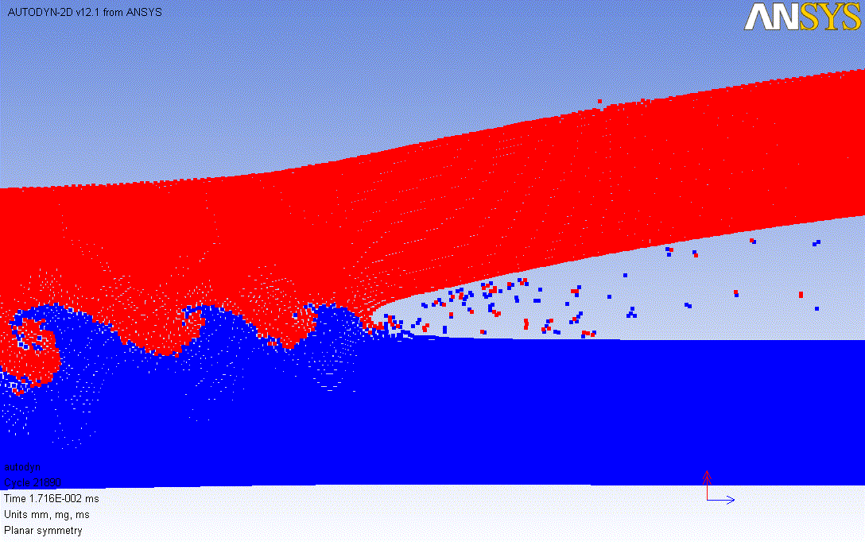
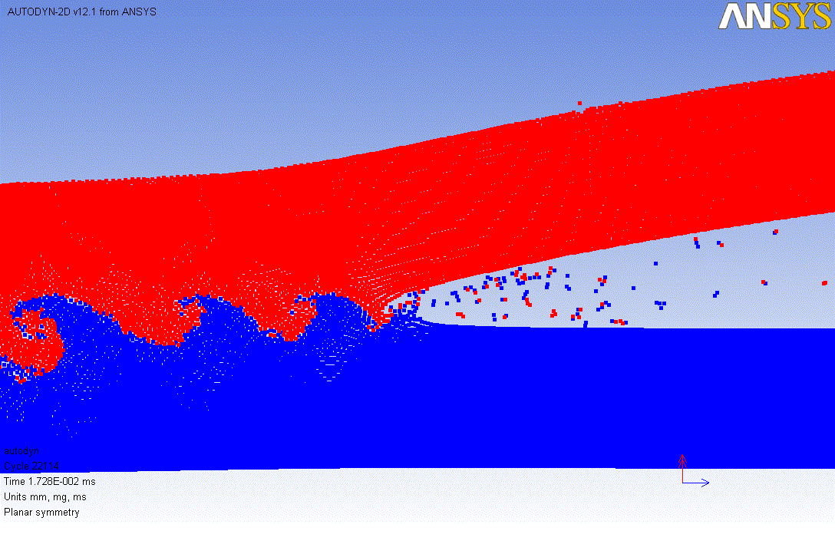
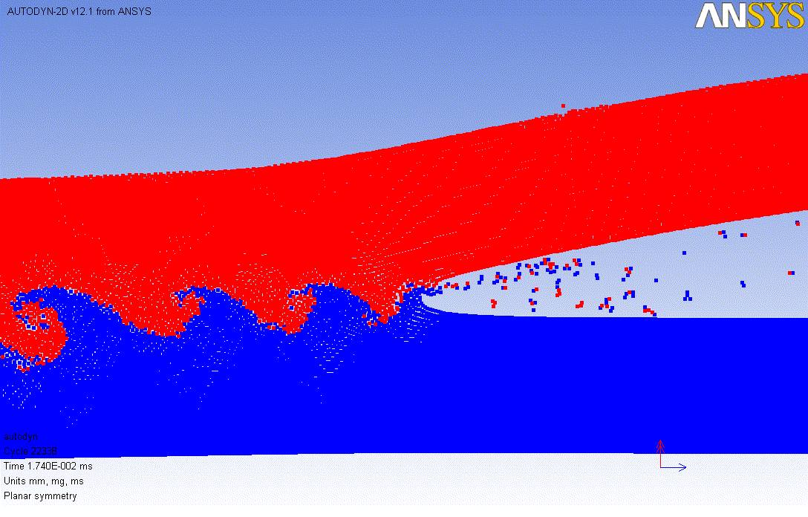
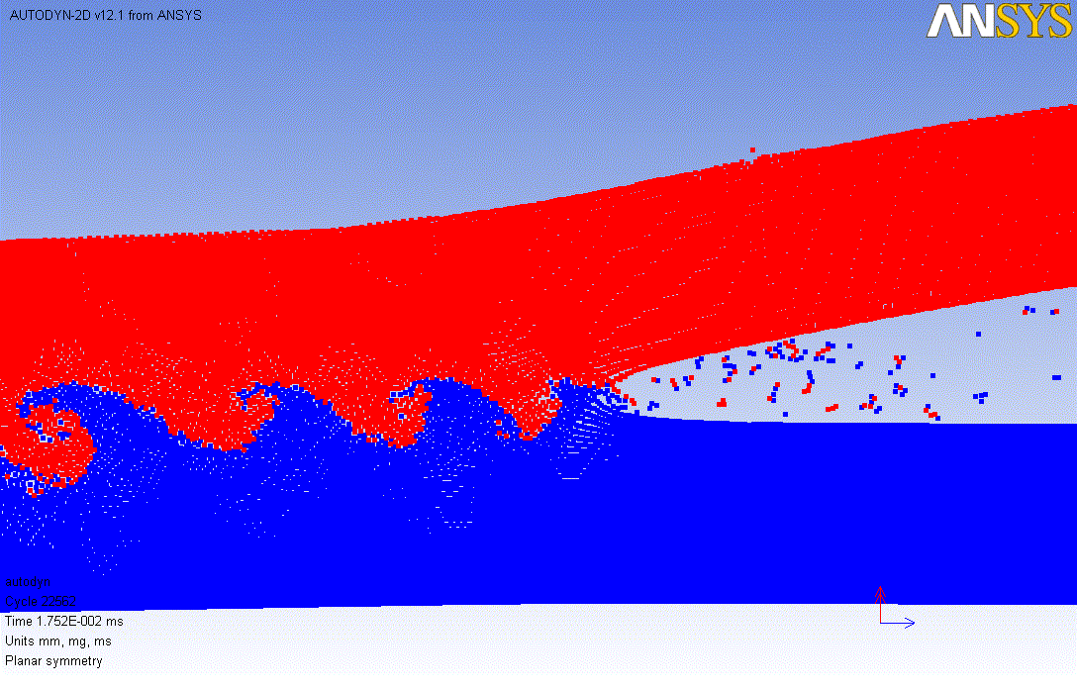
Formation of vortex at the interface

Slide 8
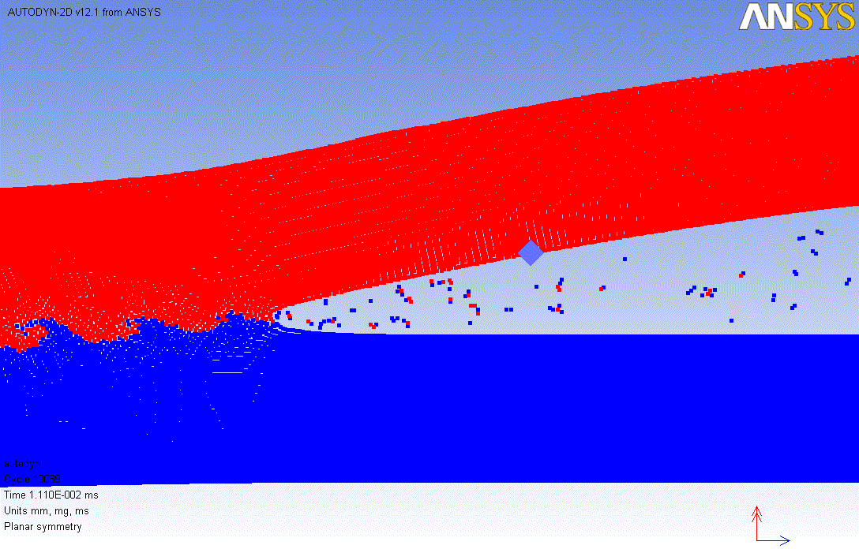
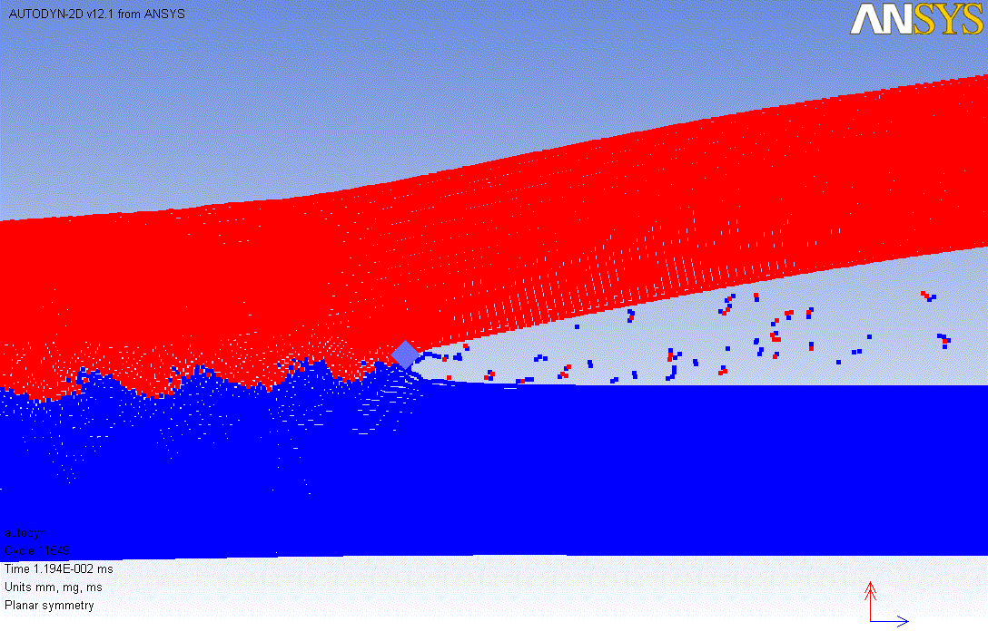
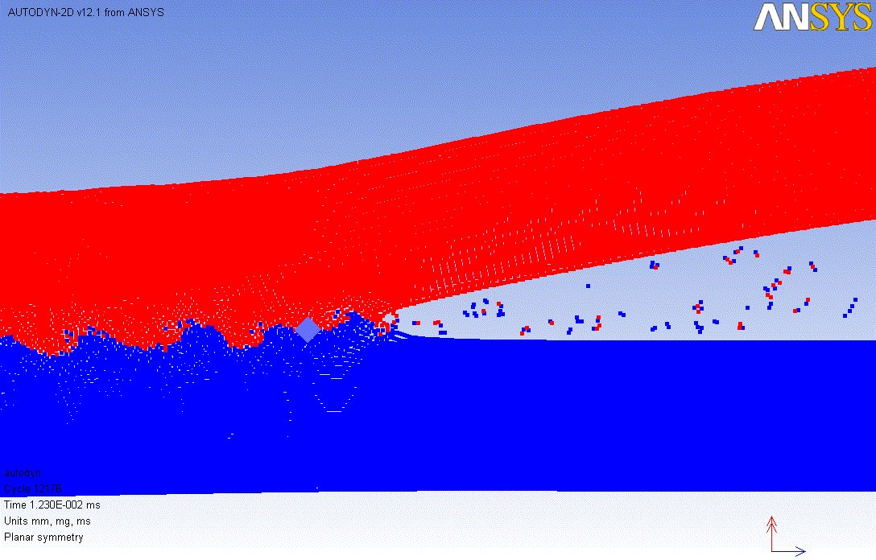
Velocity Analysis of Specific Point
t=11.10us
t=11.94us
t=12.30us

Slide 9
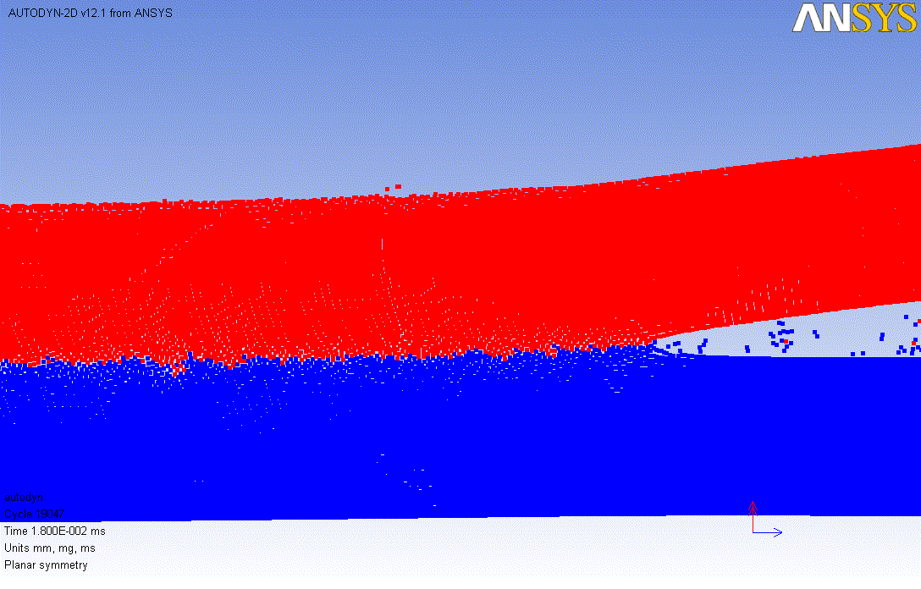
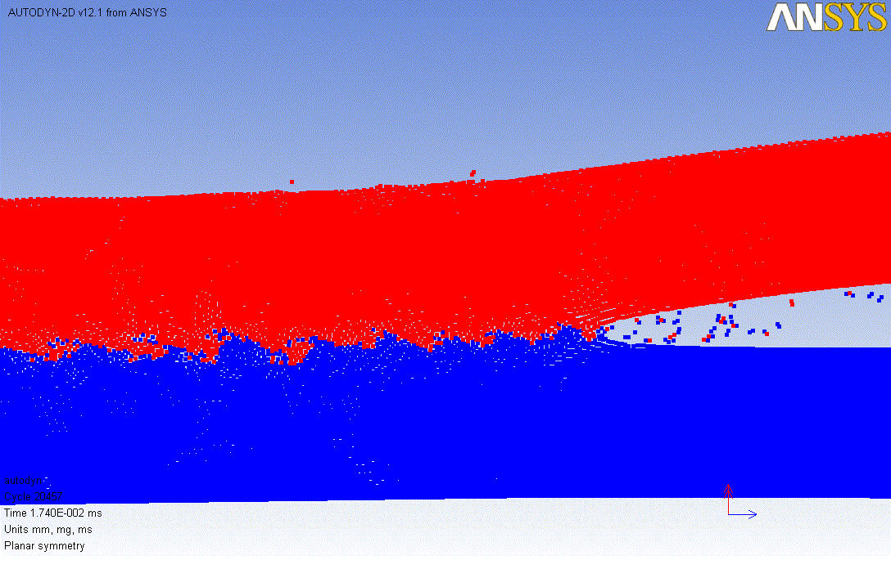
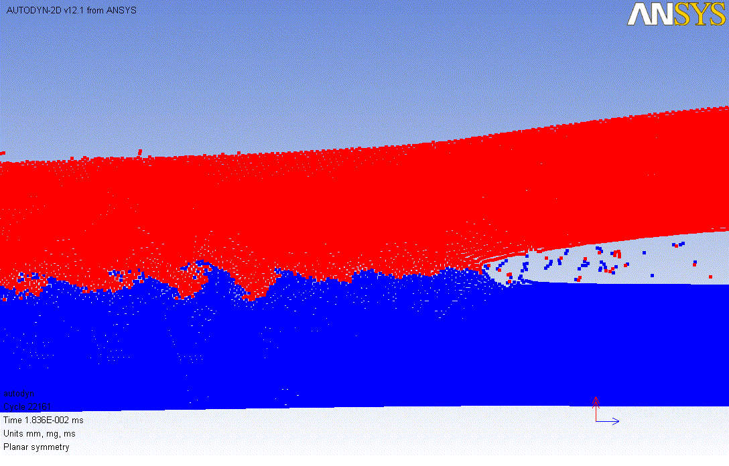
3#
Effect of Parameters on Formation of Interfacial Wave
#8
#18
Constant stand-off distance：1mm
Increasing explosive thickness：5mm-9mm-18mm

Slide 10
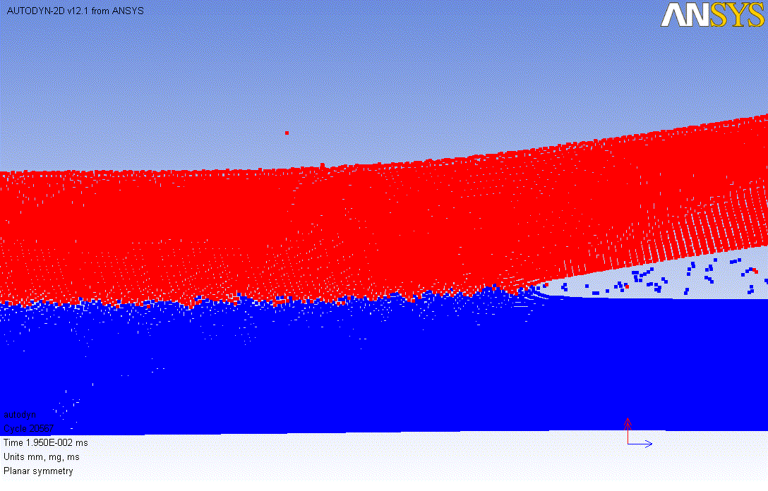
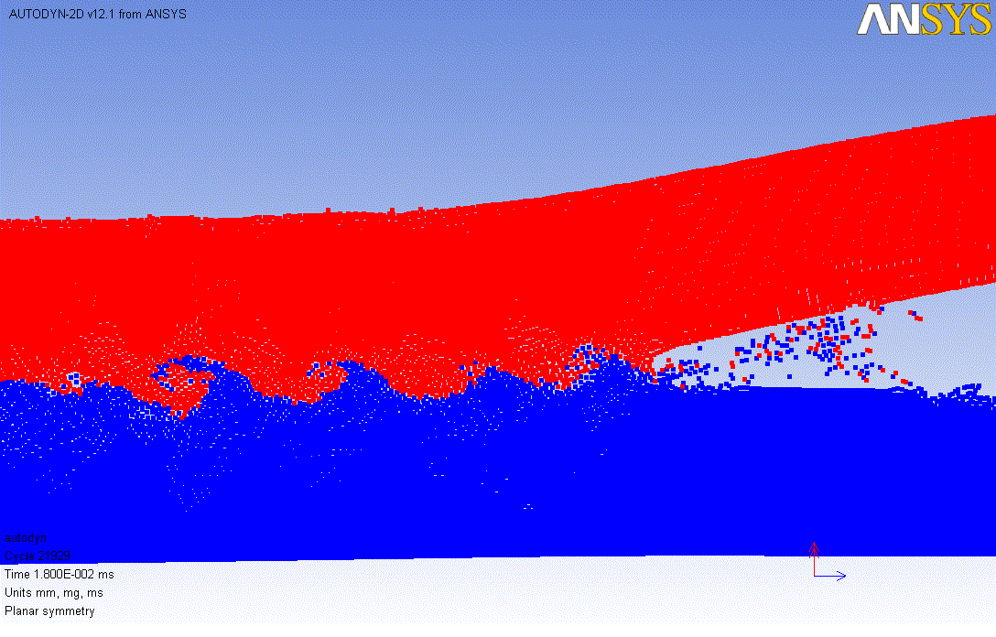
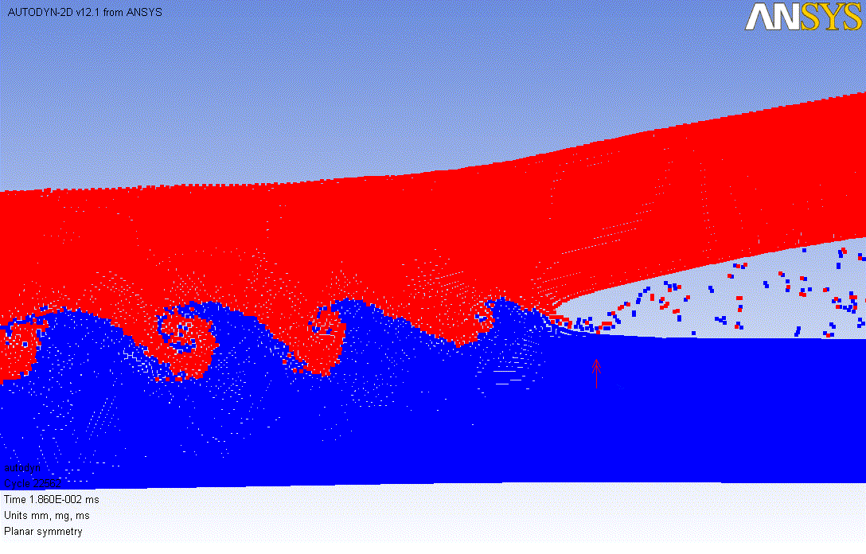
4#
9#
19#
Constant stand-off distance：2mm
Increasing explosive thickness：5mm-9mm-18mm

Slide 11
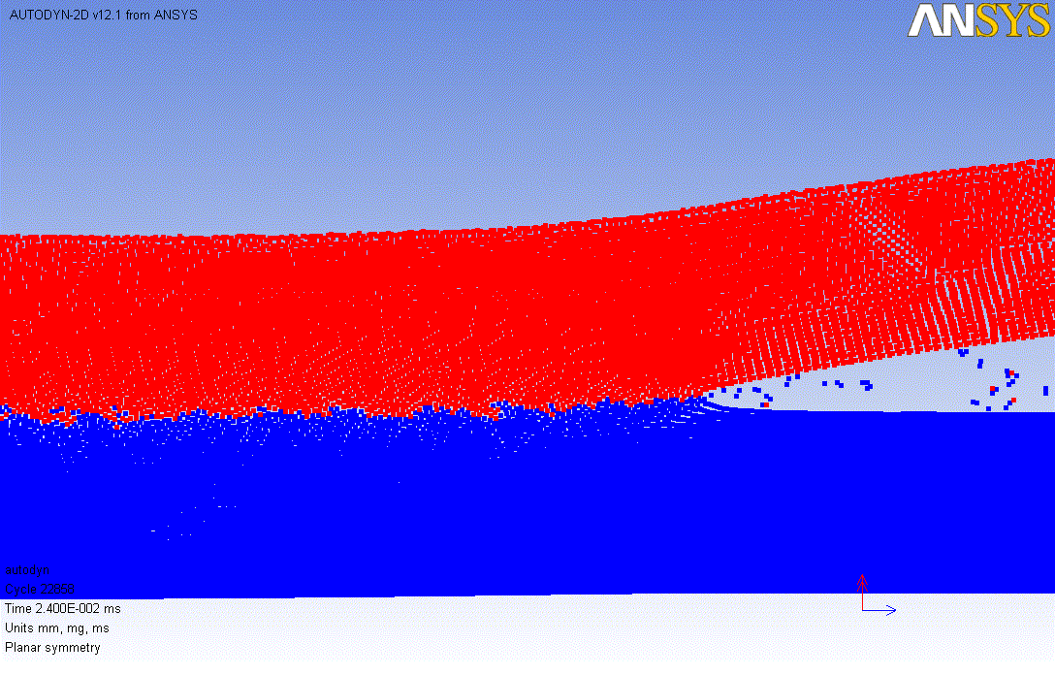
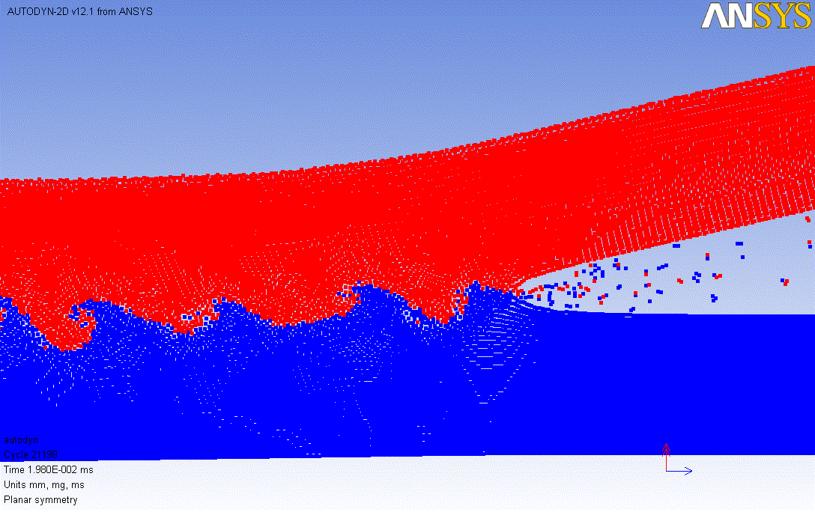
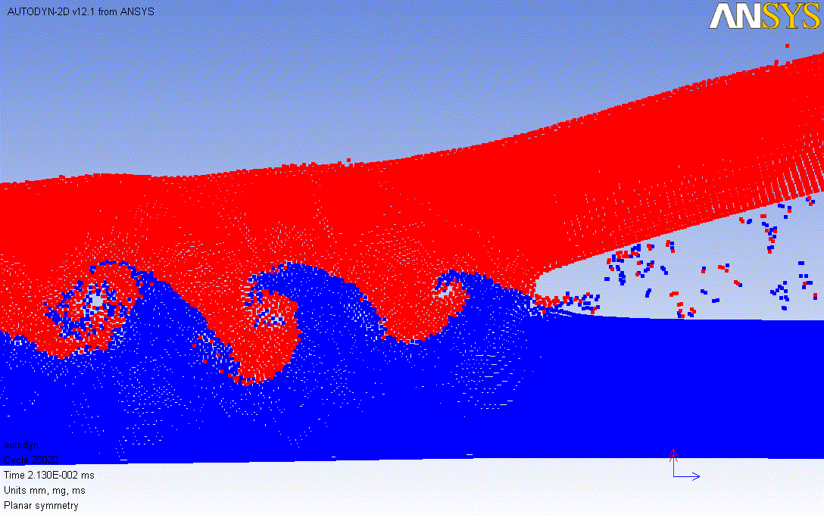
5#
10#
20#
Constant stand-off distance：5mm
Increasing explosive thickness：5mm-9mm-18mm

Slide 12
Thank You for Your Attention

Slide 13


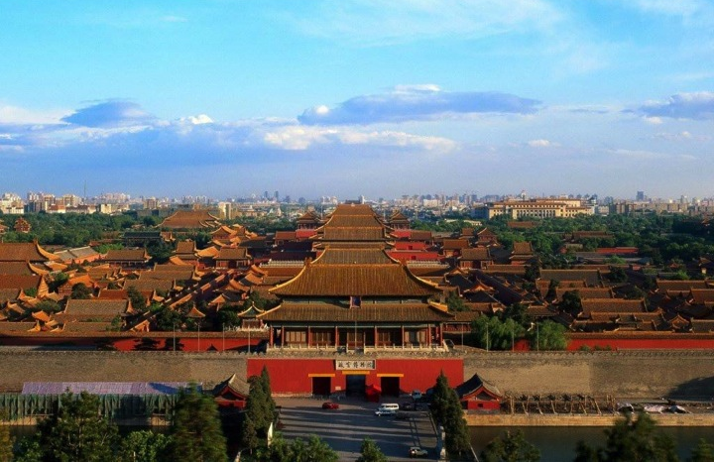

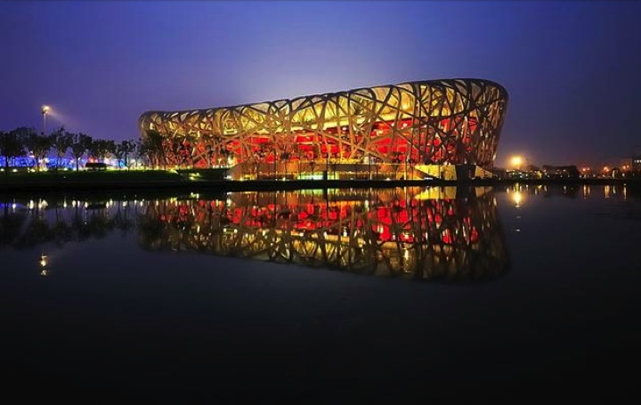
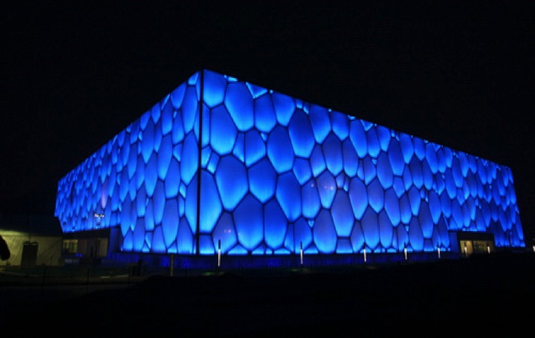


5th Symposium on Explosion, Shock wave. & High-energy reaction Phenomena (ESHP-2016 )
May 2016, Beijing, China

